Slide 1
BRIGHT
Coffee

Slide 2
agenda
Project Context
Usage Trends
Analysis
Recommendation
Closing Remarks

Slide 3
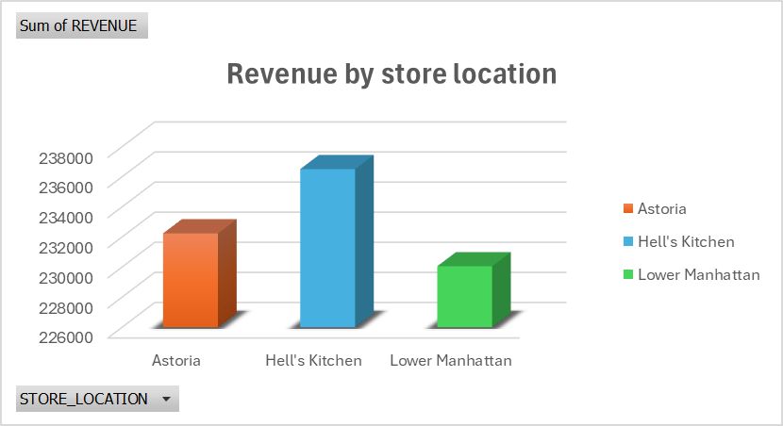
REVENUE|
Analysis By Store Location
Hell Kitchen recorded the highest revenue among the three stores.

Slide 4
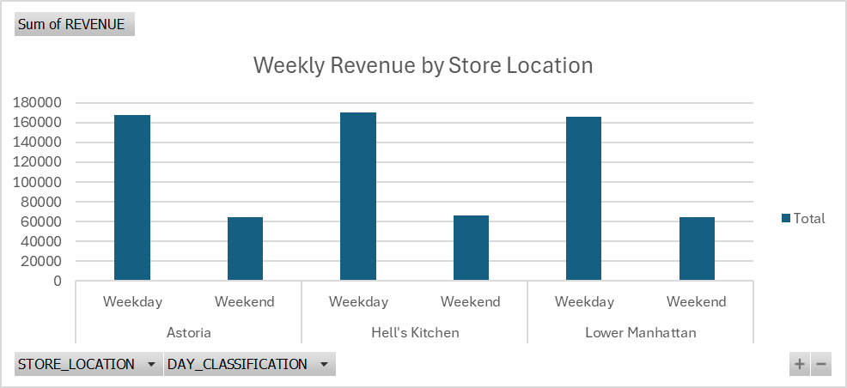
REVENUE|
Weekly Analysis By Store Location
Hell Kitchen performed better on weekdays , followed by Astoria then Manhattan. Poor performance was recorded over the weekend

Slide 5
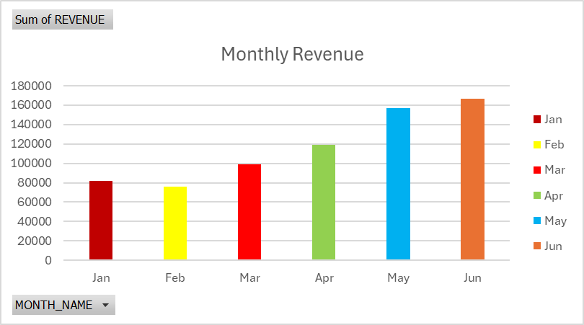
REVENUE|
Analysis By Month
June and May recorded the highest revenue reason people consume coffee more in winter.

Slide 6
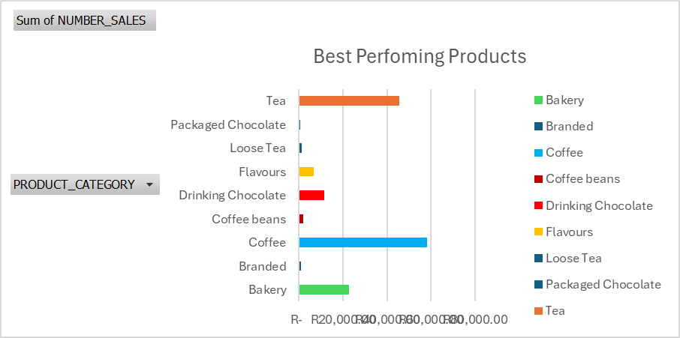
REVENUE|
Analysis By Products
Coffee is our best performing product, followed by tea then Bakery. Packed Chocolate is the least among all the products.

Slide 7
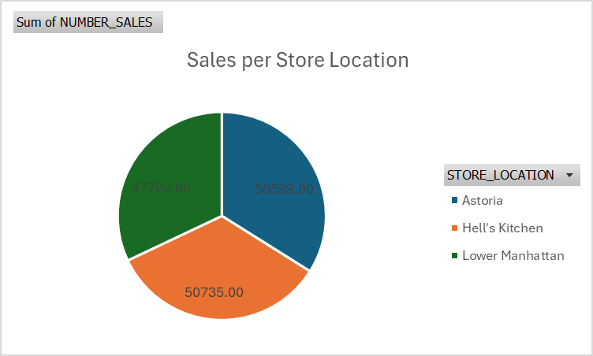
SALES |
Analysis By Store Location
Hell kitchen recorded the highest sales among the stores

Slide 8
recommendation
How to increase revenue growth
.Daily targets must be increased and new strategies must be piloted.
.Implementing automated daily reporting will sustain data-driven decision making.
.Company must implement rewards system to reward highly performing employees
.Digital system must be implemented to introduce discounts to constant clients.

Slide 9
Remarks
Bright Coffee performed higher by 10.5% compared to the previous year.

Slide 10
Thank you

